Slide 1
A View on the Future of Sakai
Charles Severance
Sakai PMC Chair
LongSight, Inc.
University of Michigan

Slide 2

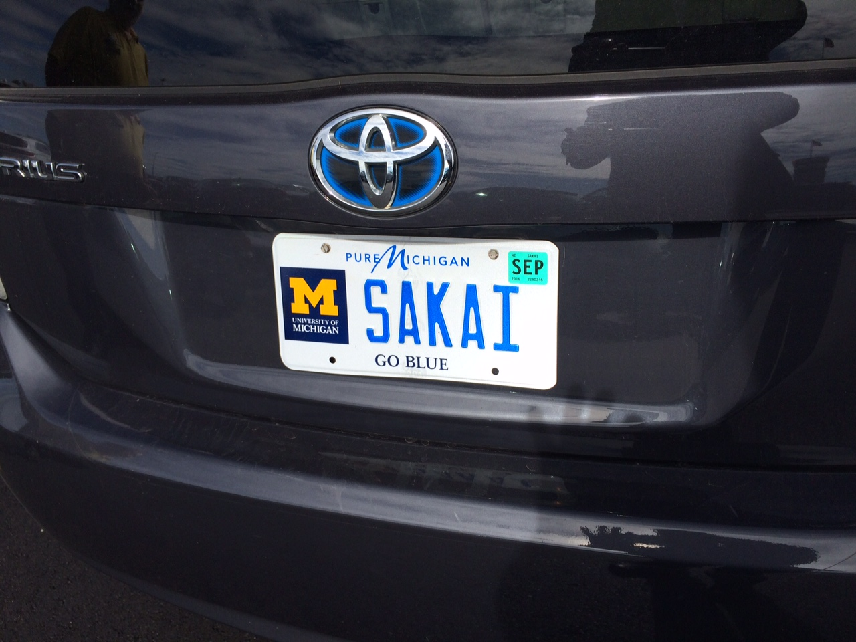
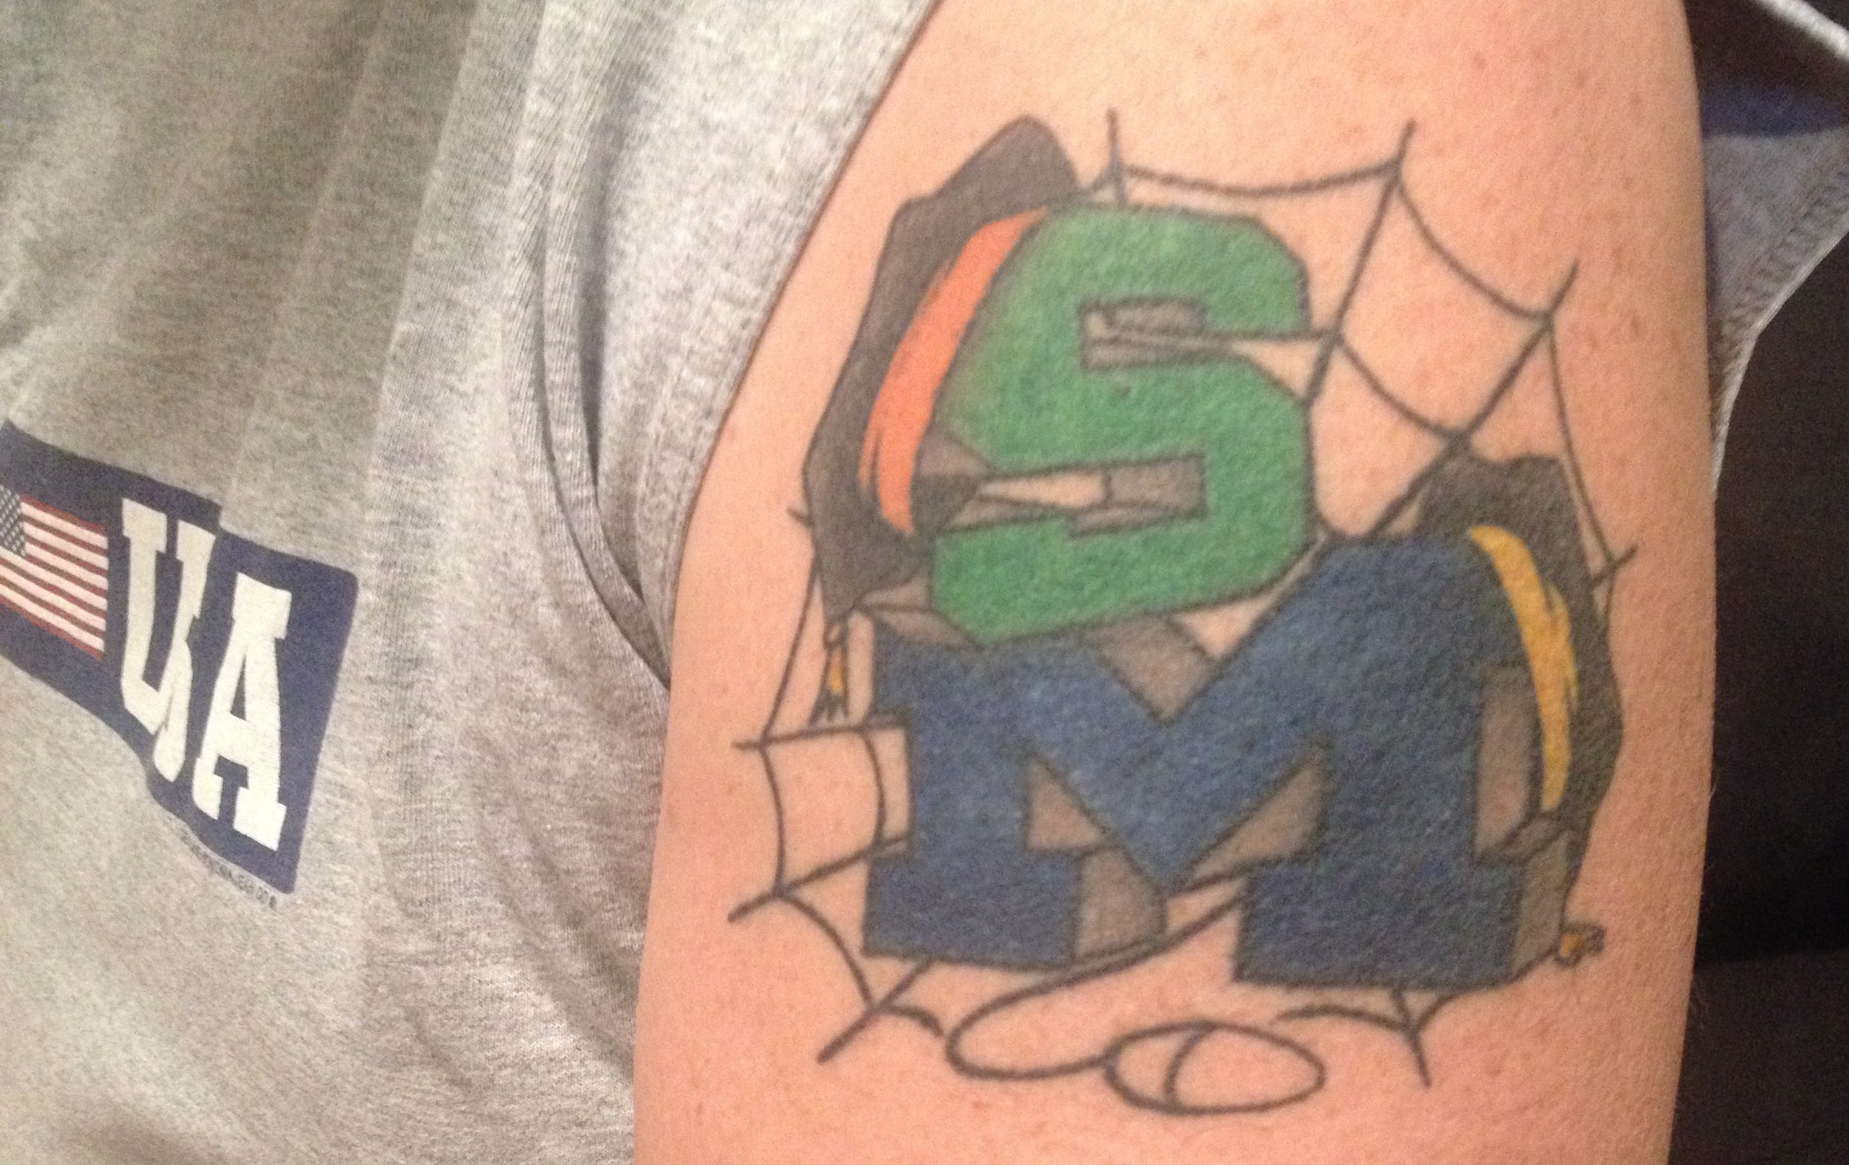

Slide 3
Sakai-11 Big Picture
Morpheus / Frameless
Most skinnable, flexible responsive UI markup in the market
We are so lucky to be not Angular and not React
New Gradebook – reduces the glitter gap
Best "Lessons" tool in the market has improved - responsive
Removed OSP
Switched to Github

Slide 4
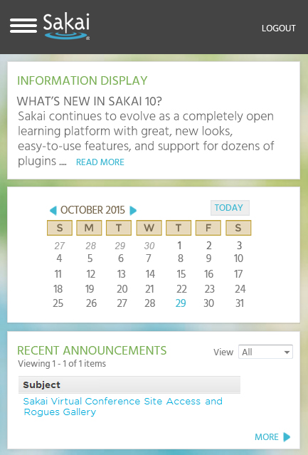
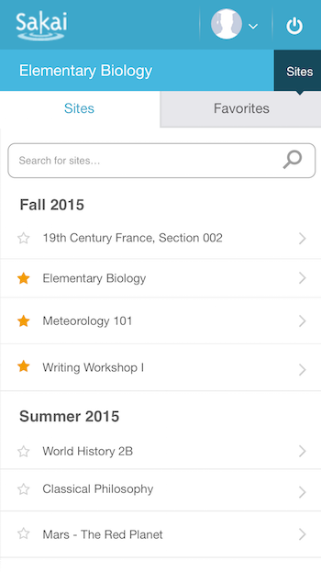
Sneak Peek: Sakai Skin Contest

Slide 5
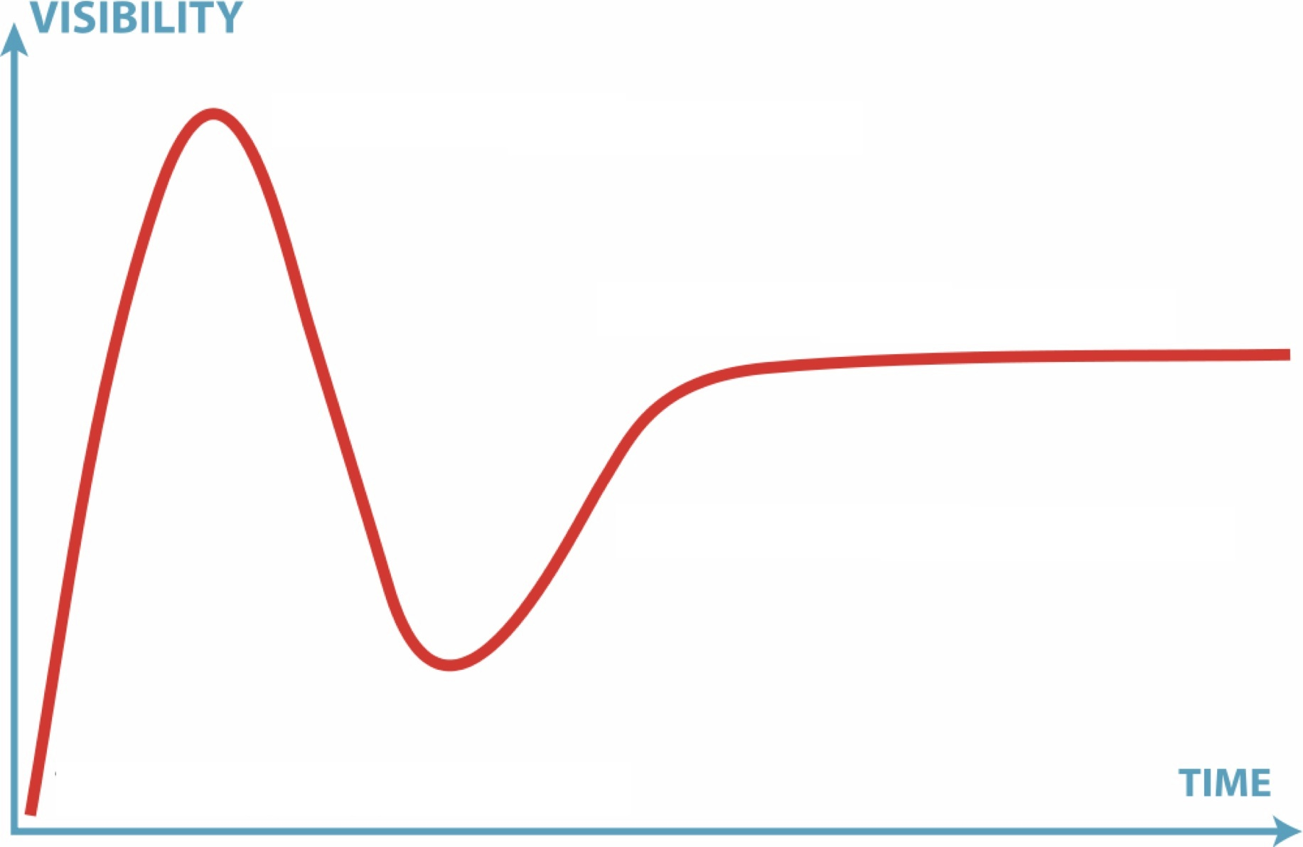

11
2.9
10
2.6
2.7
2.8
2.5
2.0
1.0
1.5

Slide 6
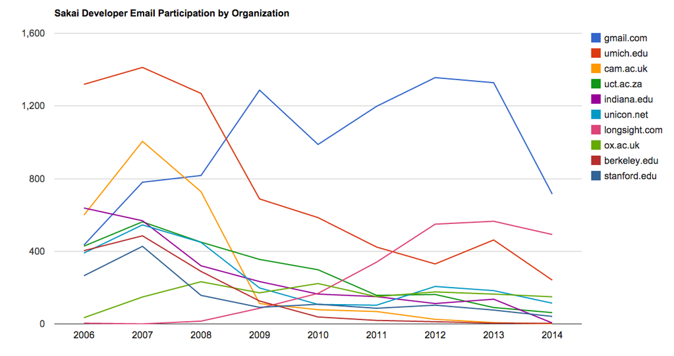
Community Transitions....

Slide 7
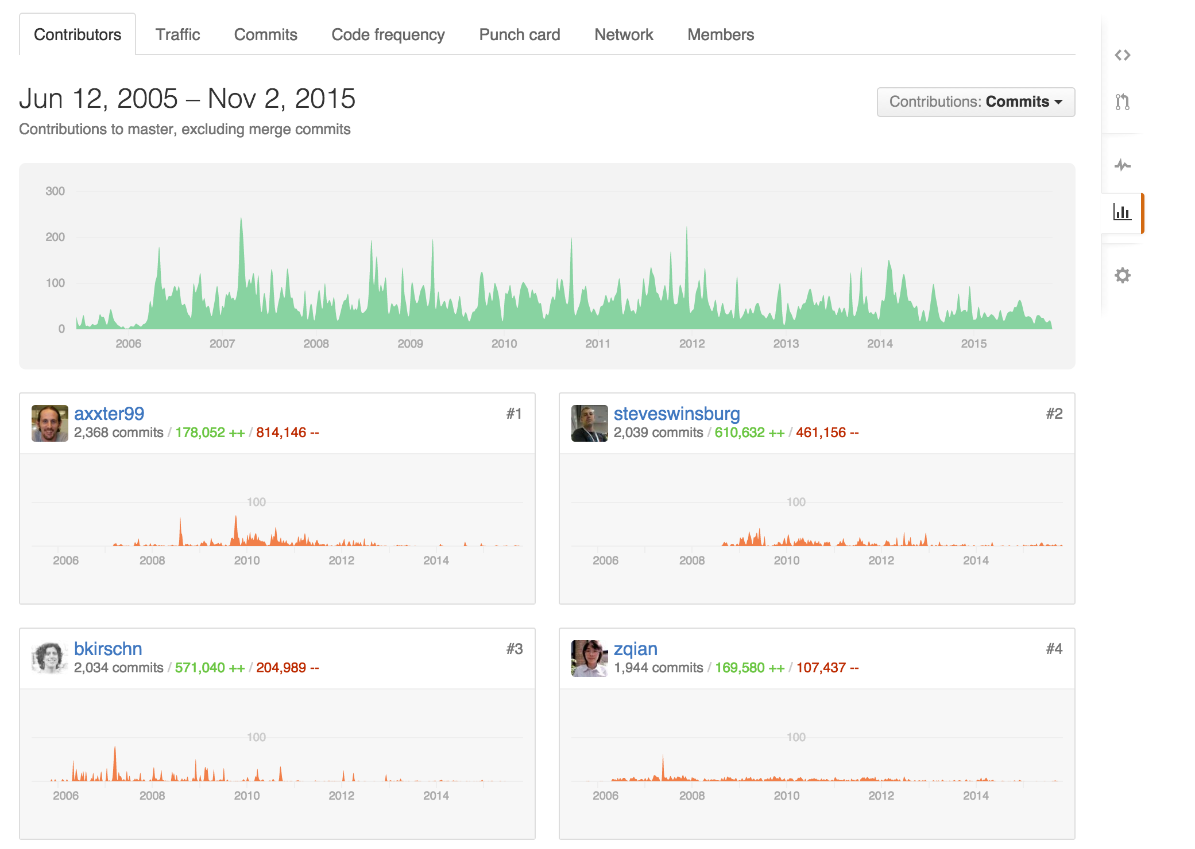

Slide 8
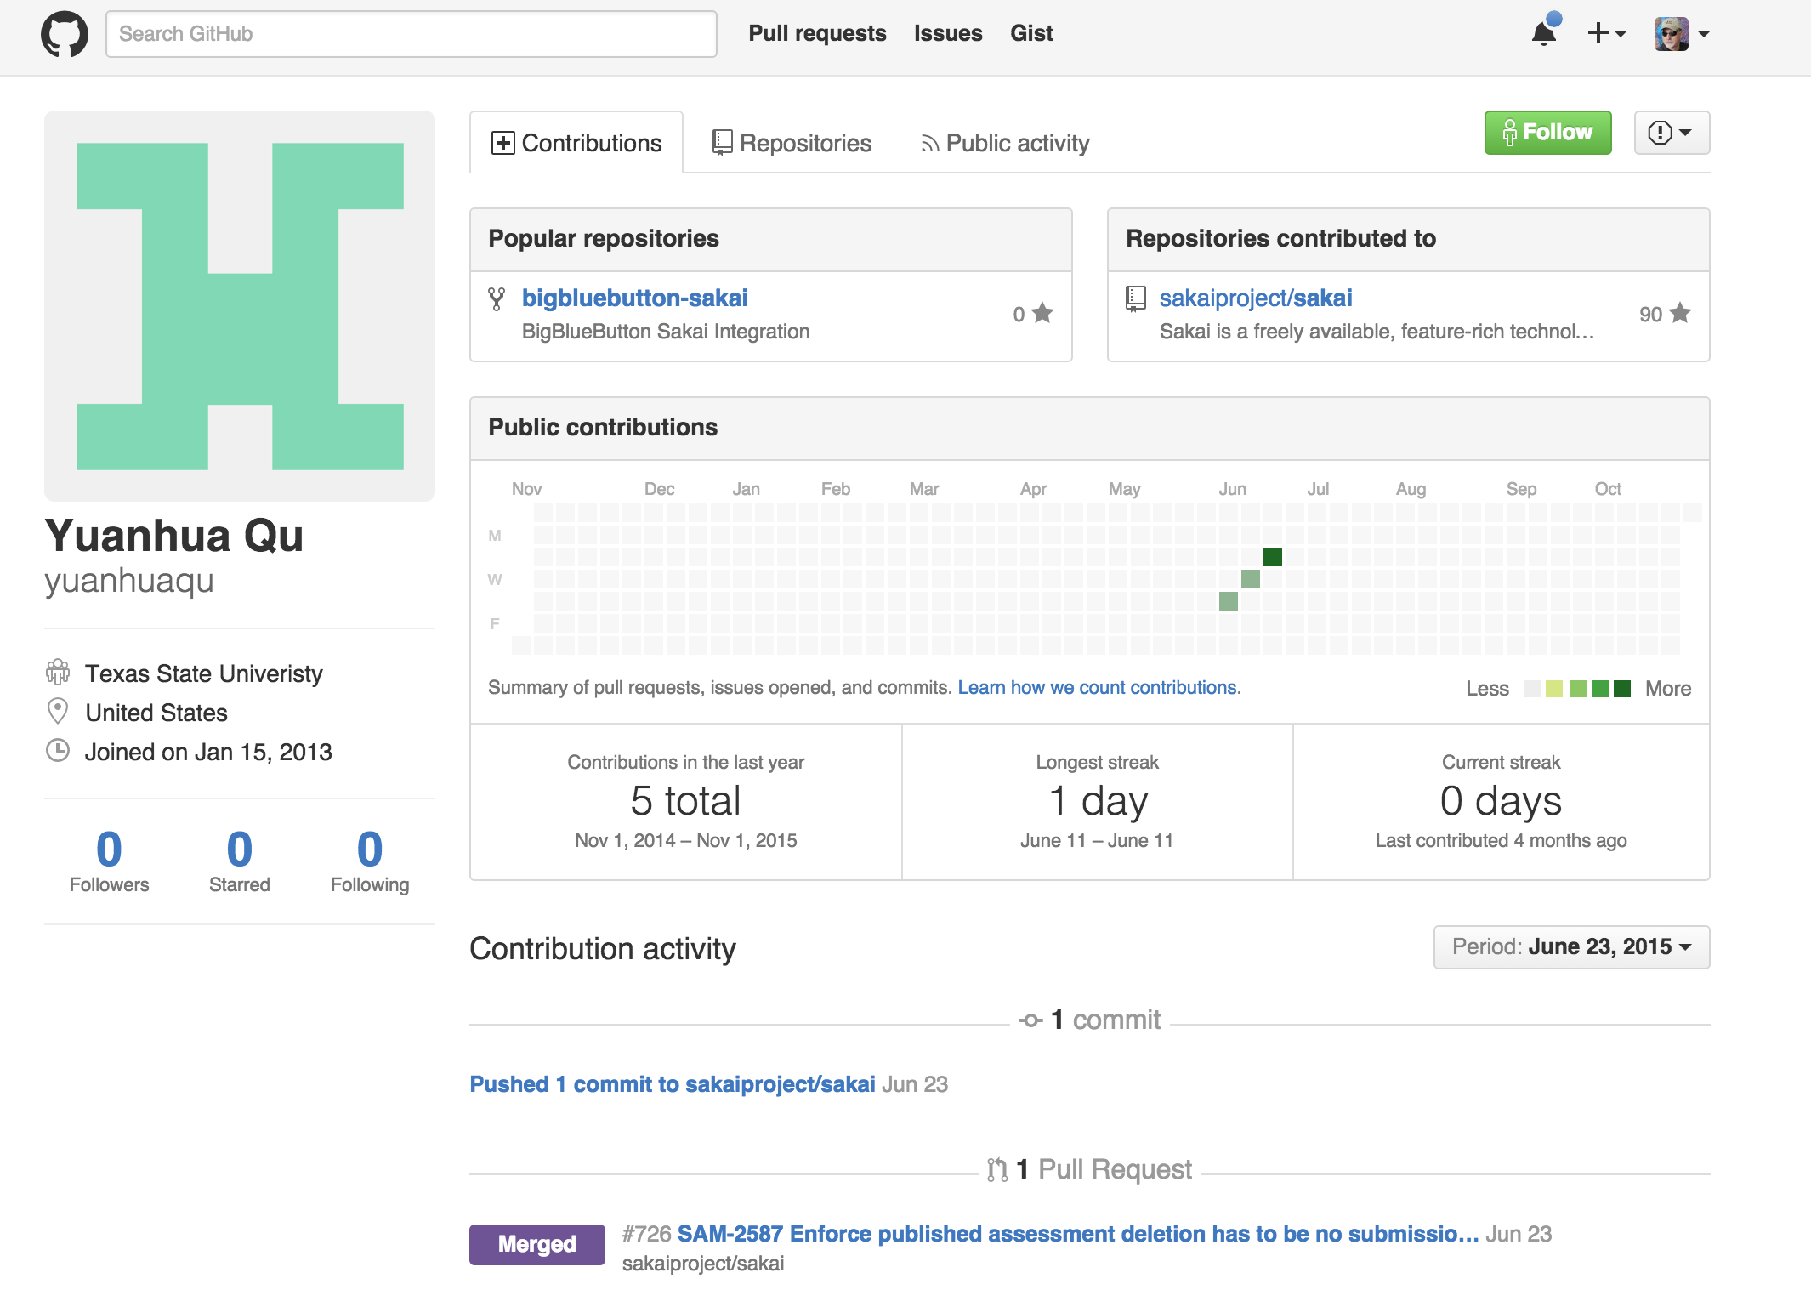
https://github.com/sakaiproject/sakai/graphs/contributors

Slide 9
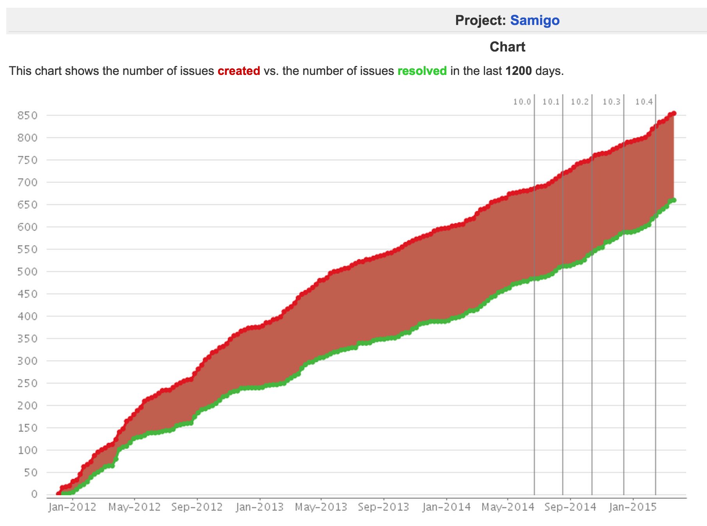


S2U – Sakai
Spanish Users

Slide 10
Community Development....
12?
11
2.9
10
2.6
2.7
2.8
2.5
2.0
1.0
1.5

Slide 11
???
11
2.9
10
2.6
2.7
2.8
2.5
2.0
1.0
1.5

Slide 12
Beyond Sakai-11
May evolve to a "run the trunk" continuous upgrade community
Go over the UI with a fine tooth comb
Responsive everywhere
Improve usability
May do UI / UX moon shots from time to time
Evolve to true multi-tenancy at app layer
Amazon Aurora – enable multi-tenant database servers

Slide 13
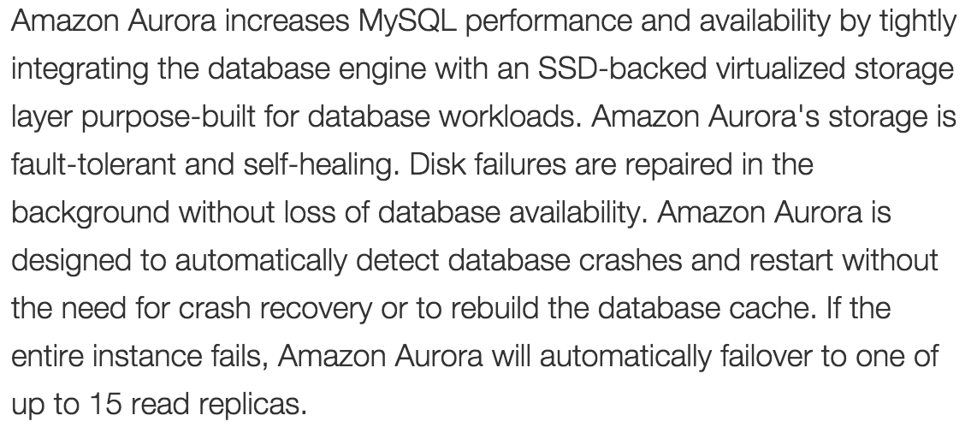
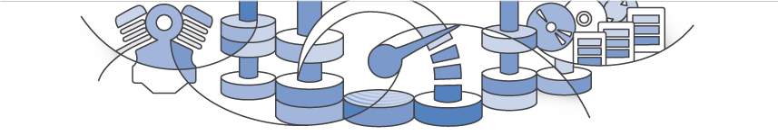

Slide 14
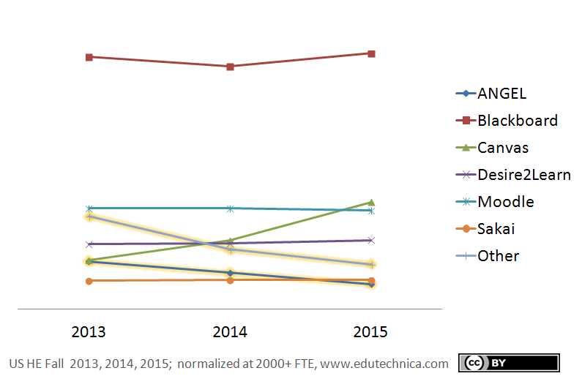
Sakai in the Market

Slide 15
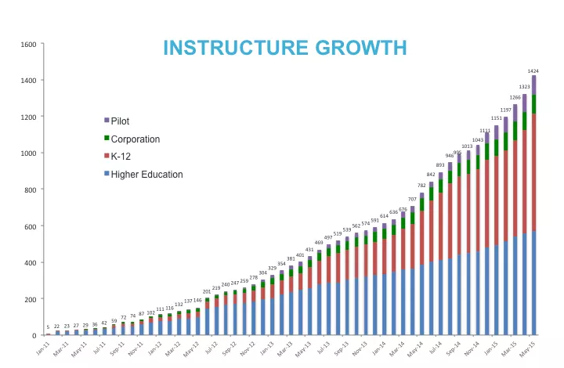

Slide 17
Standards – Expansion
IMS Common Cartridge – 1.0, 1.1, 1.2, 1.3, 2.0
IMS Learning Tools Interoperability 1.0, 1.1, 2.0, 2.1, 2.2
IMS LTI Content Item - Public Draft
IMS LTI Roster Services – WG Draft
IMS LTI Outcomes Services – in WG Draft
IMS Caliper 1.0
IMS OneRoster – Rest-based SIS integration
IMS CASA – WG – Draft
IMS CC / EPUB 3.0 Coordination

Slide 18
Standards Score Card
LMS | LTI 1.x | Common Cartridge | Content Item | LTI 2.x | Caliper
Canvas | A | A | A | B+
Sakai | A | A | A- | A-
Moodle | A | A | B | B
D2L | A | A
Blackboard | A | A

Slide 19
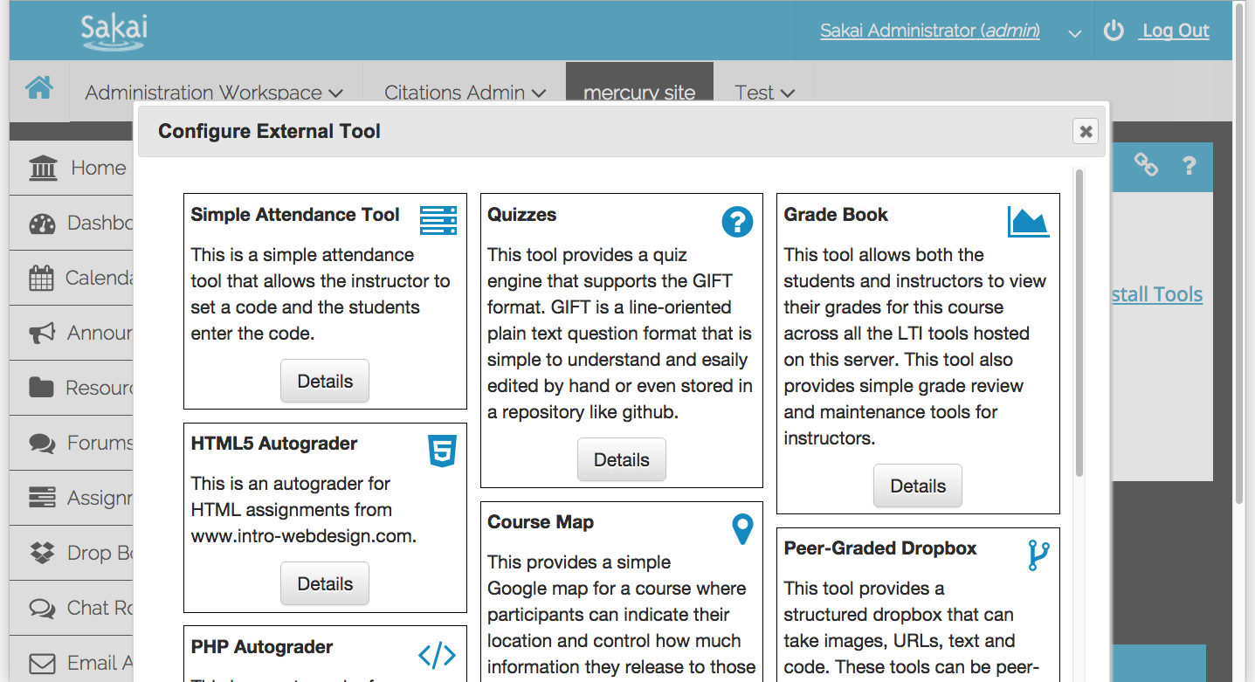
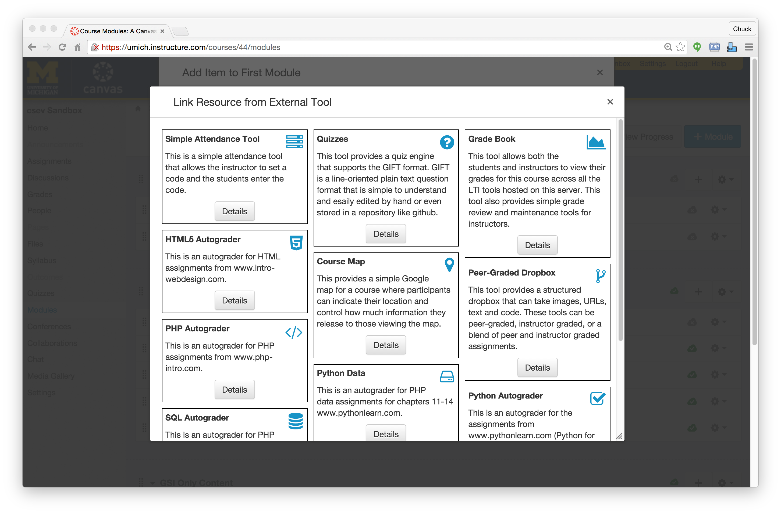

Slide 21
Strategery...

Slide 22
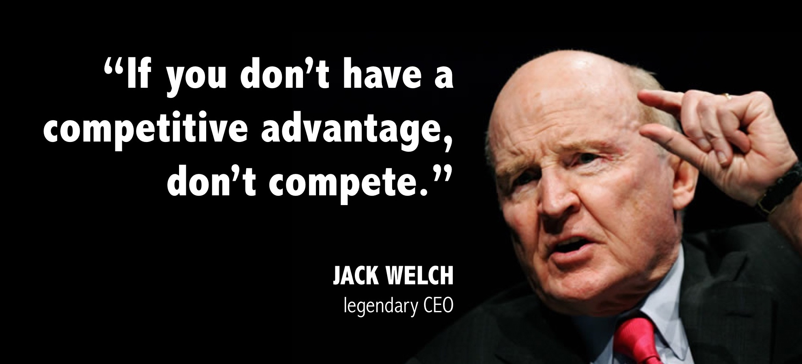
Jack Welch

Slide 23
From: 2012-04-24-free-as-in-freedom

Slide 24
From: 2012-04-24-free-as-in-freedom

Slide 25
From: 2012-04-24-free-as-in-freedom

Slide 26
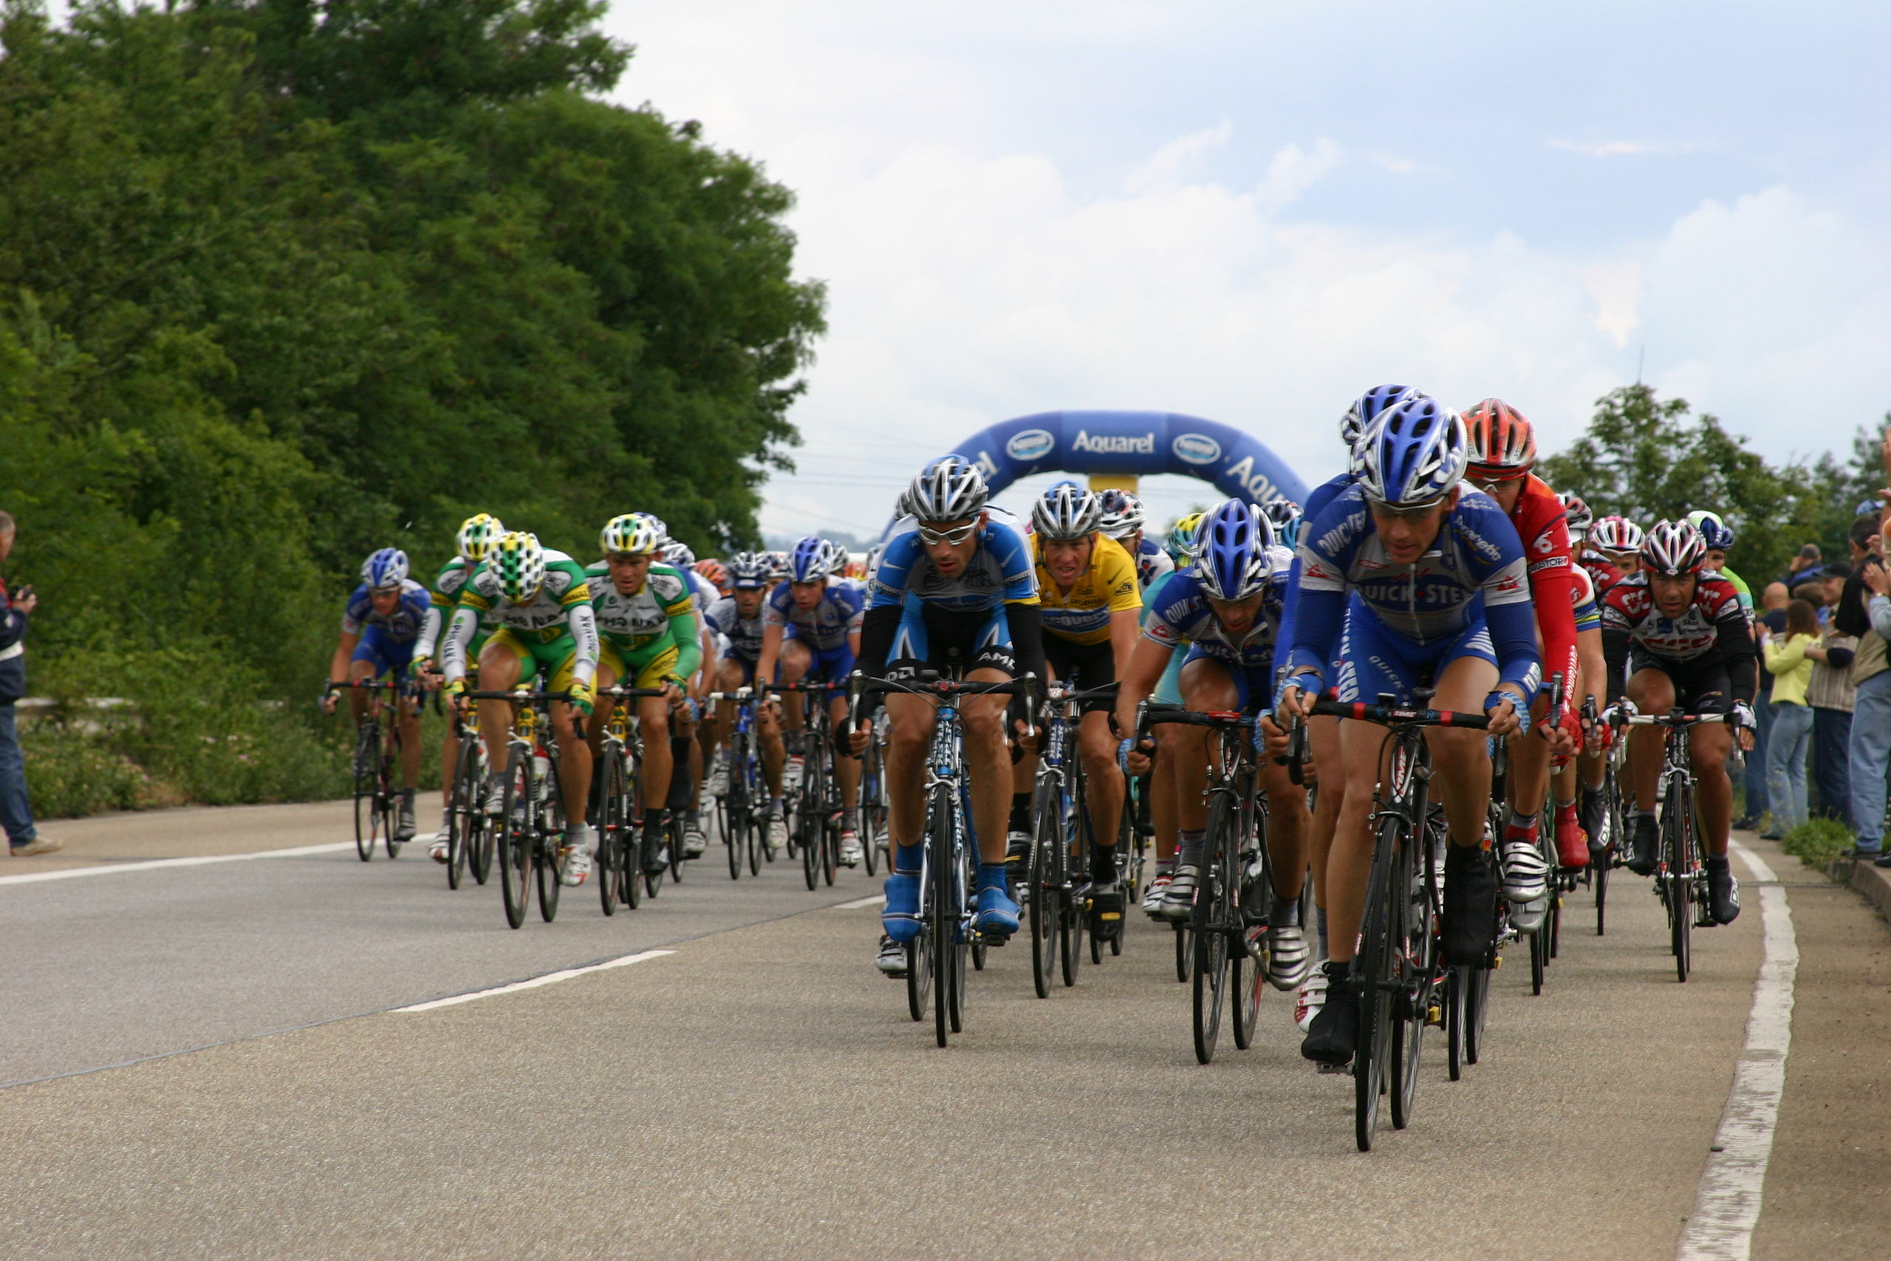
https://en.wikipedia.org/wiki/Peloton#/media/File:TourDeFrance_2005-07-08.JPG

Slide 27
The LMS Peloton
Draft / cooperate to save resources
Within teams and among teams
Stay near the front
Never let the leading team out of your sight
Match the leading team
Wear the teams behind you out without wasting your own energy
Leverage the attention generated by the lead team

Slide 28
Standards Score Card
LMS | LTI 1.x | Common Cartridge | Content Item | LTI 2.x | Caliper
Canvas | A | A | A | B+
Sakai | A | A | A- | A-
Moodle | A | A | B | B
D2L | A | A
Blackboard | A | A

Slide 29
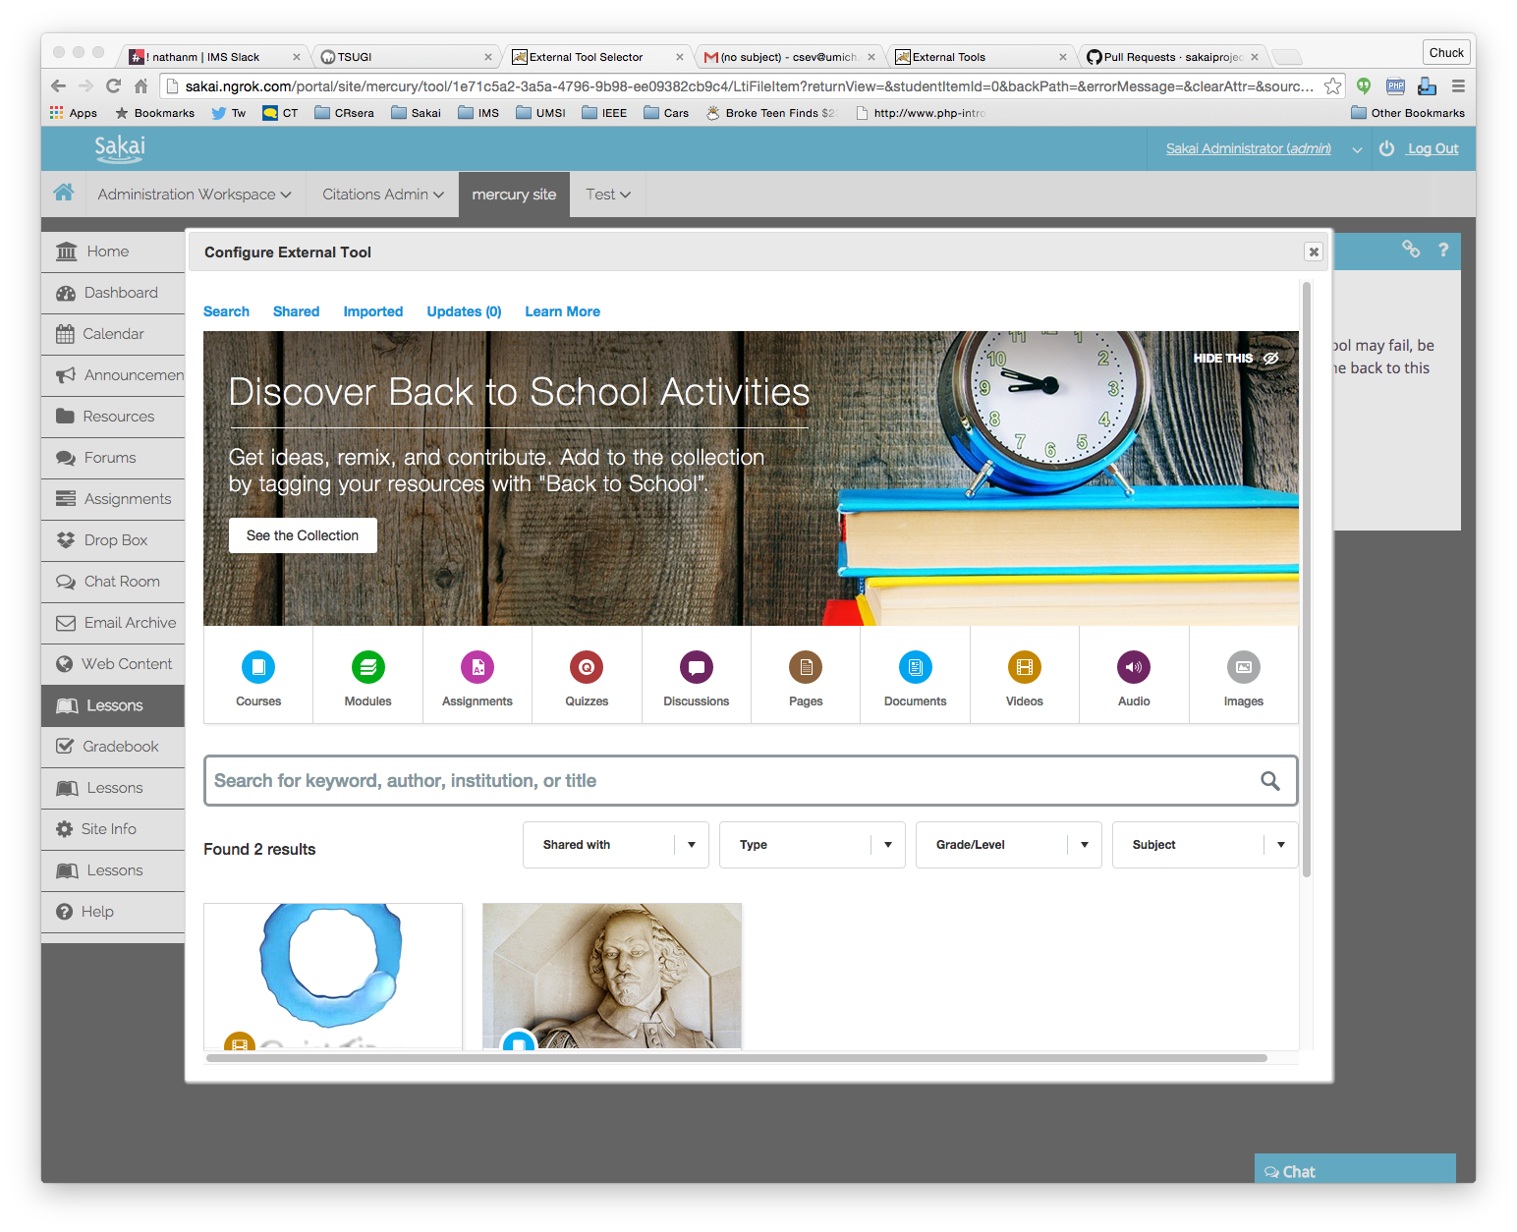

Slide 31
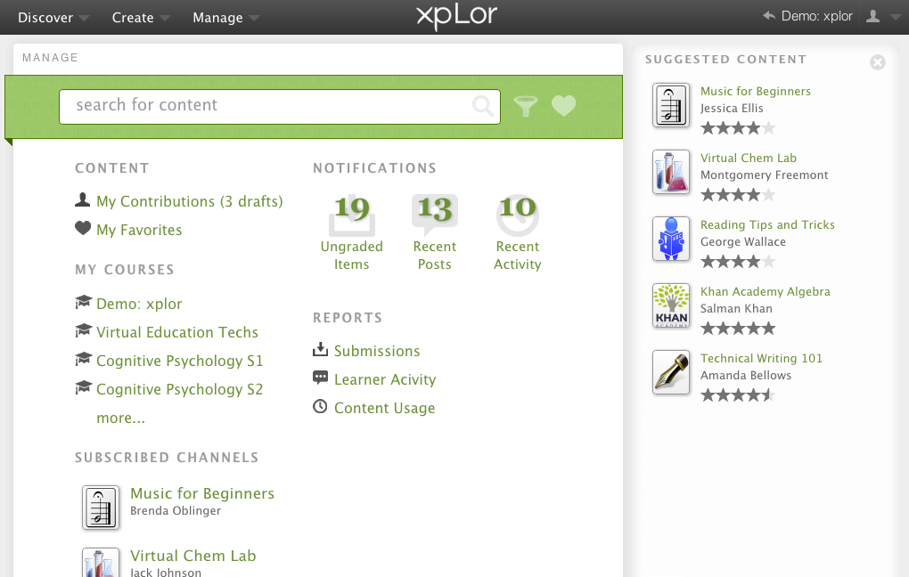

Slide 32
Next Generation Teaching and Learning
The "post-LMS"

Slide 33
Punditry..

Slide 34
Tenets of the NGTL Movement
NGTL LMSs will be small with few features
They will scale from hundreds of students to millions
Content repositories will be plentiful
Will have better powerful authoring tools than LMSs
Most features come from app stores (also plentiful)
It will scale from hundreds to millions
There will be whole new customers and revenue flows
Students
Teachers

Slide 35

LMS/UI
LMS API Provider
APP
APP
LMS/UI
APP
APP
APP
APP/UI
Content
Repository
APP/UI
APP/UI
LMS/UI

Slide 36
Early Exemplars In The Space
Repositories
Blackboard xpLor
Canvas Commons
App Store:
Canvas EduAppCenter
ELMS Network – Drupal + LTI Provider
Tsugi – www.tsugi.org
Small LMS + App Store + Straight to Teacher
Edmodo
Schoology

Slide 37
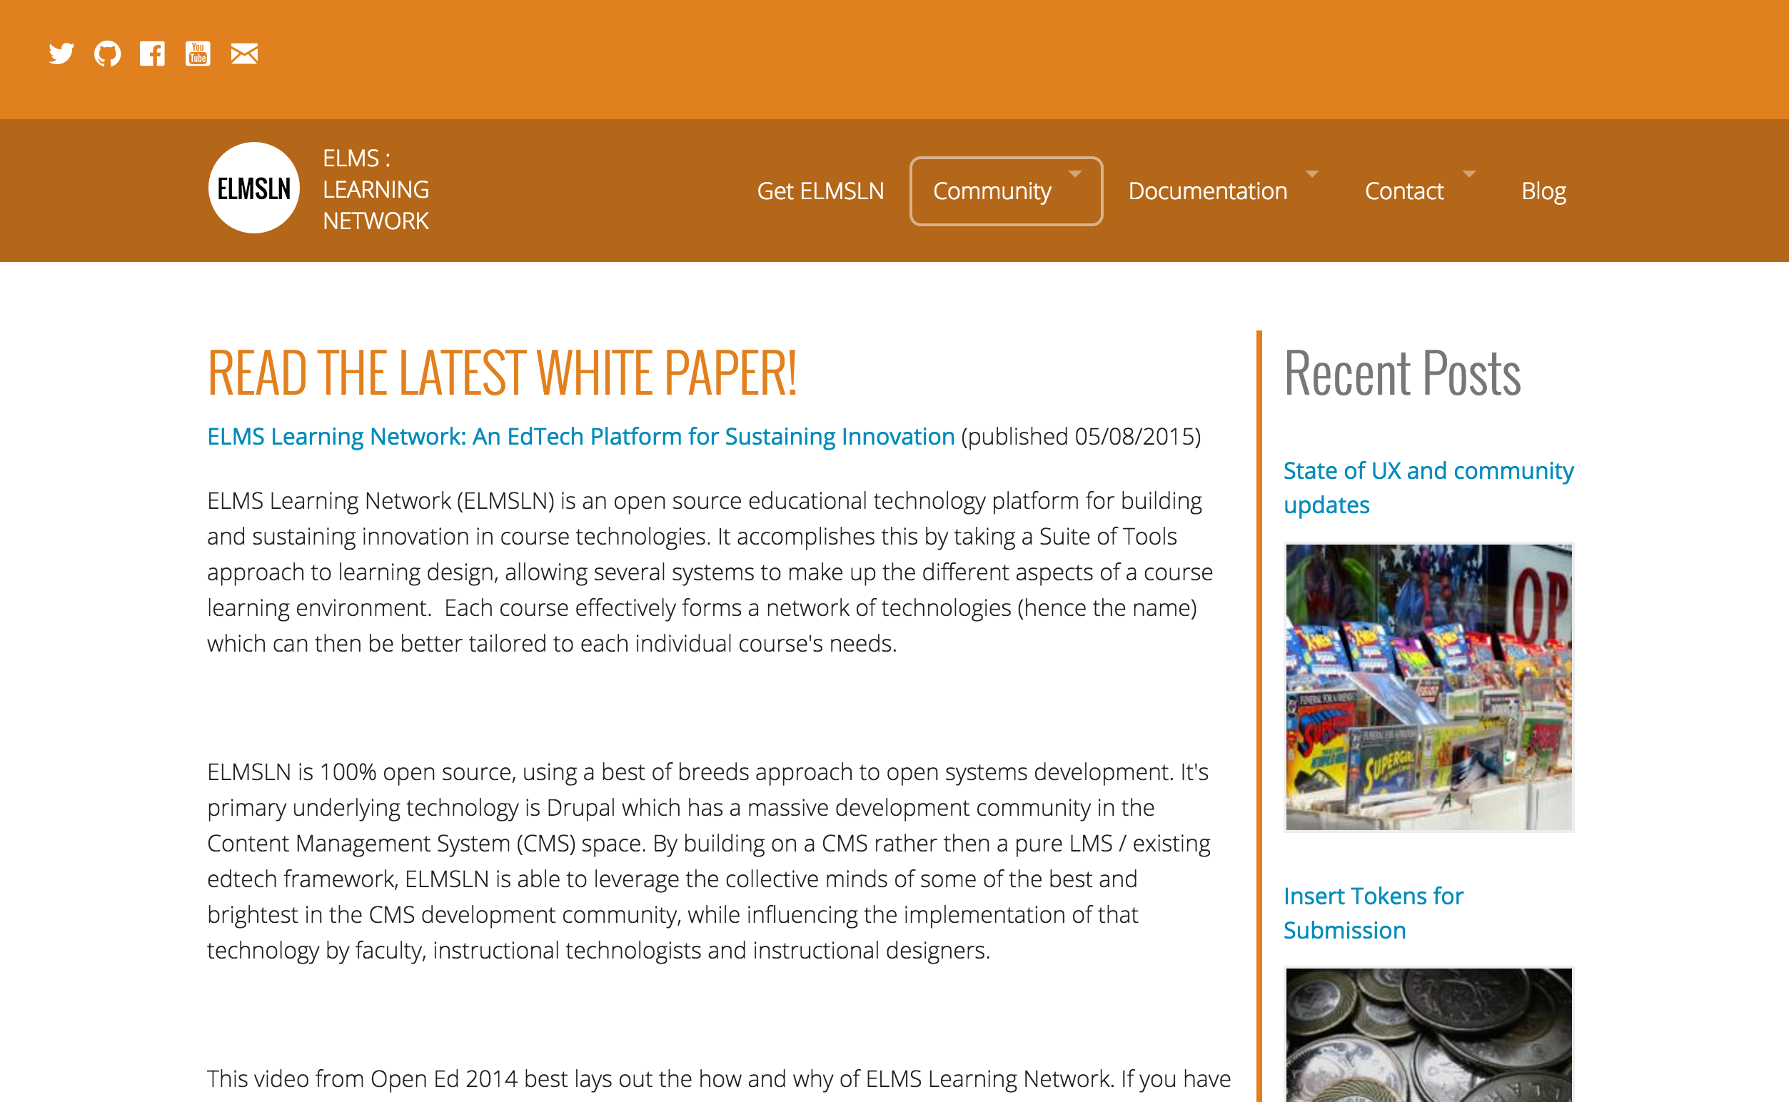
www.elmsln.org

Slide 38
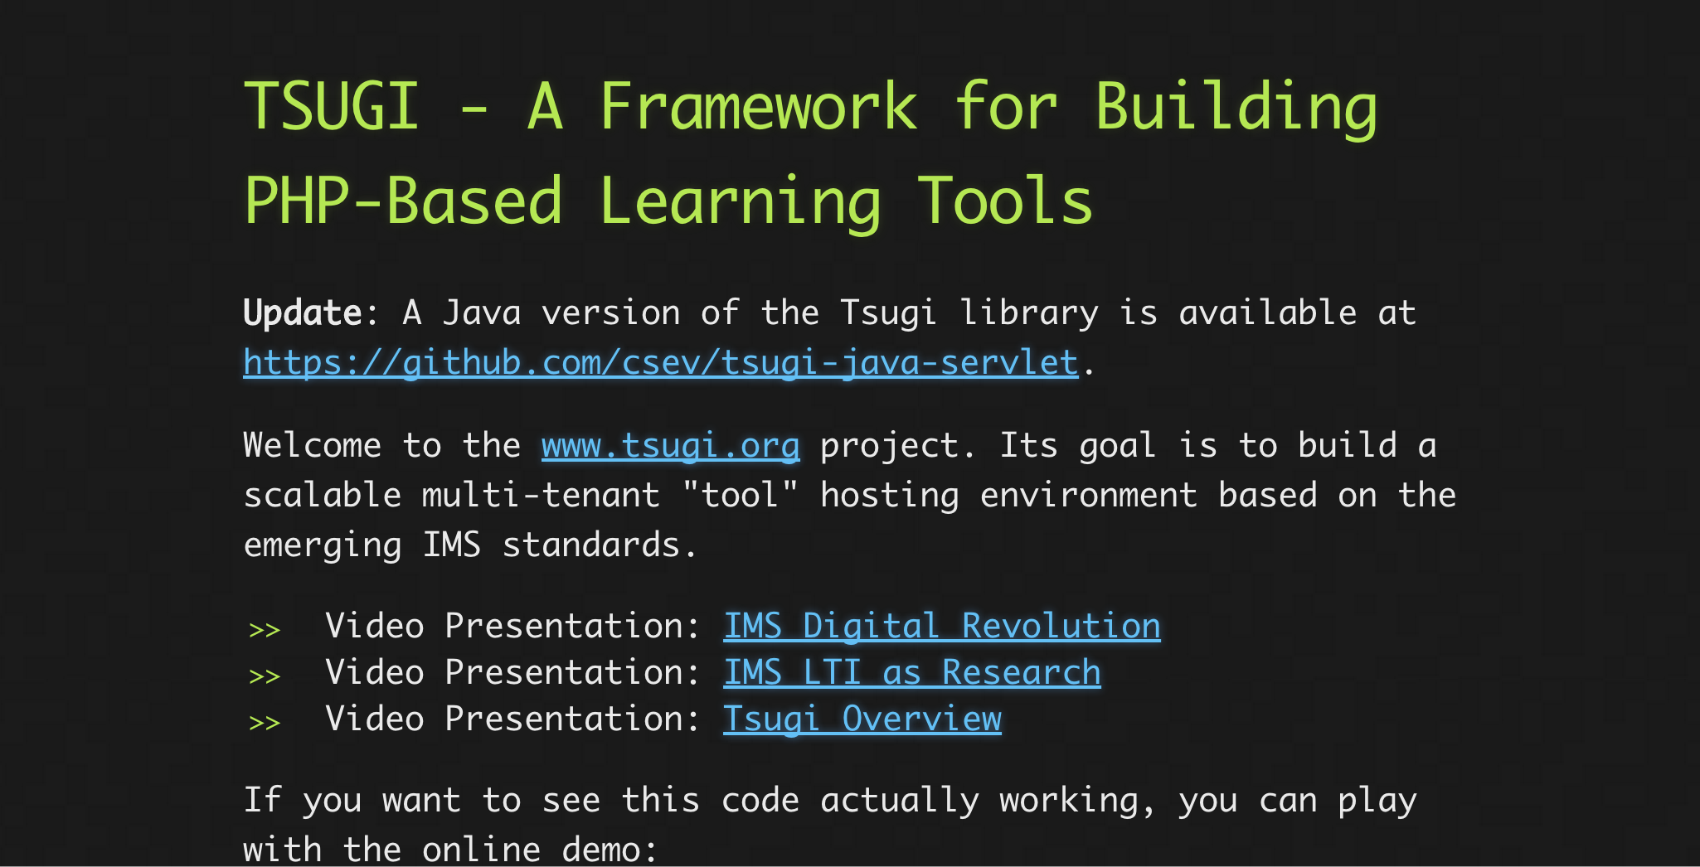
www.tsugi.org

Slide 39


Slide 40
LMS Survival Plan
Standards
App Stores
Use them seamlessly
Become an App Store
Content Repositories
Use them seamlessly
Become content a content repository (with editing, versioning, etc)
Don't fall behind, invert the model, live in the cloud

Slide 41
Open Source must lead the market into Next Generation Teaching and Learning systems

